Slide 1
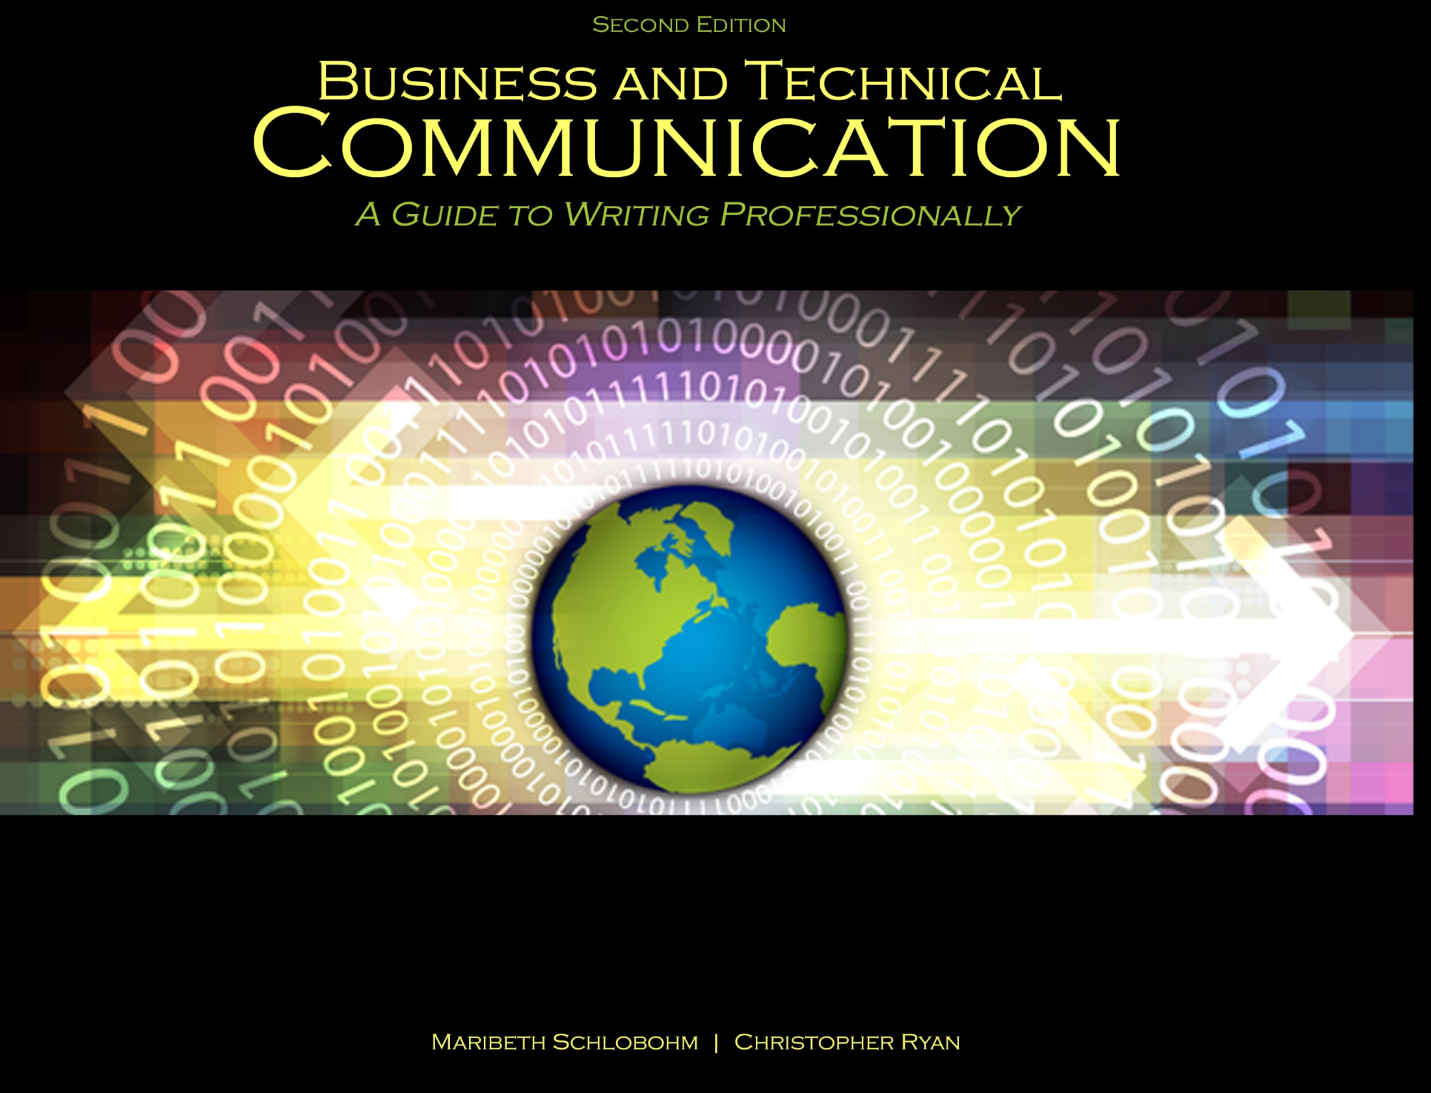
Chapter 7: Stand Alone and Supplemental Documents

Slide 2

Document Commonalities
Stand alone and supplemental functionality
Stand alone as contracts and agreements
Supplemental to:
Contracts
Reports
Proposals
Deliverables

Slide 3
Document Types
Definitions and glossaries
Instructions and specifications
Statement of Work
Policies and procedures
Manuals

Slide 4
Definitions and Glossaries
Glossaries are compilations of extended definitions
Extended Definition Elements:
Word origin
Word history
Examples
Negation
Division into parts
Similarities and differences
Analogy
Graphics

Slide 5
Instructions
Seven elements to good instructions:
List of equipment specifications
List of tools required
Diagrams identifying parts
Step-by-step process for task completion
Clear and concise language
Technical support and manufacturer contact information
Safety information

Slide 6
Specifications
In “spec” and Out of “spec” or OOS
Four required elements:
List of equipment parts, including serial numbers
Schematics or blueprints showing part placement
Description of functionality of all parts, including tables and charts
Written explanation of functionality

Slide 7
Statement of Work (SOW)
SOW common elements:
Parties
Major milestones and deliverables
Testing
Tasks
Cost of resources
Payment schedule
Period for performance
Special requirements

Slide 8
Policies and Procedures
Policies define expectations for behavior
Policies are implemented through procedures
Four common elements of policies:
Use clear and concise language
Contain one principle or concept per policy
Include warnings and set forth ramifications for failure to follow
Define how business will be conducted

Slide 9
Manuals
Manuals are compilations of instructions, procedures, and specifications
Manuals use illustrations, including:
Diagrams
Charts
Tables
Pictures
Schematics
Blueprints
Specifications

Slide 10
Manual Types
User guides
Owner’s or operator’s manuals
Technical manuals
Instructions
Maintenance manuals

Slide 11
References
Schlobohm, Maribeth and Christopher Ryan. Business and Technical Communication: A Guide to Writing Professionally, 2nd Ed., Dubuque, IA: Kendall-Hunt, 2014. Print.

Slide 12
Contact Information
Kendall-Hunt Publishing Company
4050 Westmark Drive
Dubuque, IA 52004-1840
http://www.kendallhunt.com
Toll Free: 800-228-0810

